Slide 1
MS21911958
SMART
E-TEXTBOOK
APPROACH IN
SRI LANKA
RESEARCH PRESENTATION II B. R. M. S. R. B. RATHNAYAKE
RESEARCH SUPERVISION DR. KALPANI MANATHUNGA
DR. DHARSHANA KASTHURIRATHNA
Notes:
Project proposal presentation
Introduce Dr.Dharshana as an external supervisor

Slide 2
INTRODUCTION
02
Problem Statement
Innovative Solution
Target audience
Novelty & Significance of the research
Notes:
Sri Lanka being a third-world country it faces so many challenges, n public education is one of them.
Adolescents who attend government schools undergo several additional efforts which can be considered as academic barriers.
target audience - students and teachers (who engage in primary or secondary education under the government sectors)
Significance of the research is to reduce printing costs for textbook, address student’s health, promote green technology, to make learning easier

Slide 3
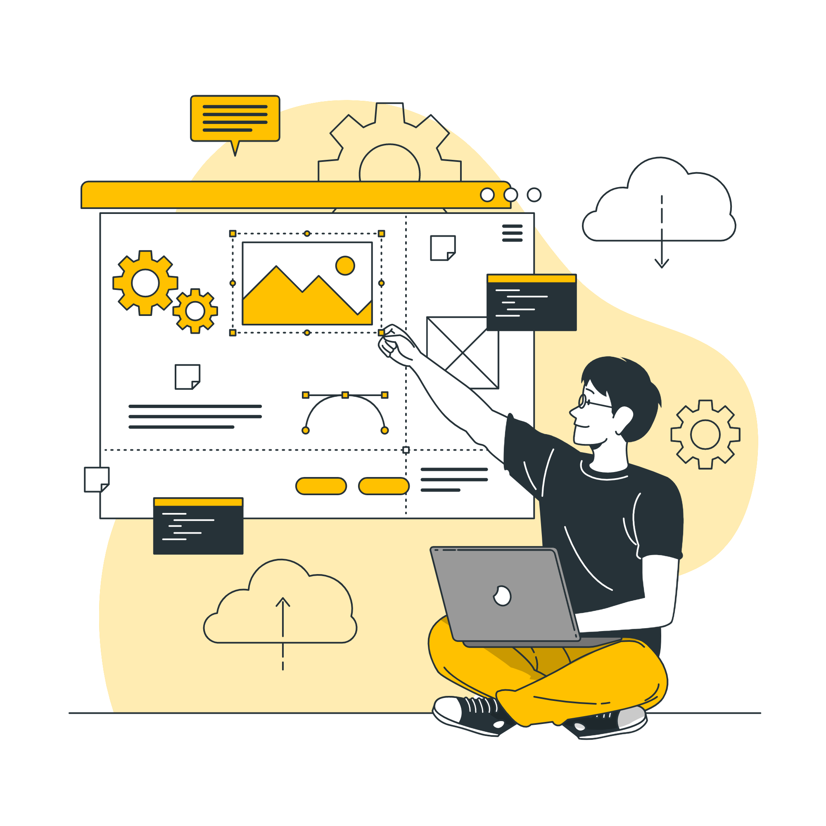
Potential Approaches for Sinhala Textbook Summarization
03
Generative models - Generative Pre-trained Transformer 3 (GPT-3) will be utilized to generate a Sinhala summary
Transformer models - Various deep learning models powered by Google Brain (Google’s AI)
LSTM models will be analyzed for text summarization possibilities
Transfer language - instead of training the model from the beginning, closely related languages with similar grammar can aid Sinhala textbook summarization
Other stemming mechanisms and algorithms discussed in the literature review
External libraries and techniques that can be used for the Sinhala language
Notes:
Main focus would be generative models or transformers (deep learning models) finding the best out of those.

Slide 4

What is GPT-3?
04
Generative models - Generative Pre-trained Transformer 3 (GPT-3) will be utilized to generate a Sinhala summary
Transformer models - Various deep learning models powered by Google Brain (Google’s AI)
LSTM models will be analyzed for text summarization possibilities
Transfer language - instead of training the model from the beginning, closely related languages with similar grammar can aid Sinhala textbook summarization
Other stemming mechanisms and algorithms discussed in the literature review
External libraries and techniques that can be used for the Sinhala language
Notes:
Main focus would be generative models or transformers (deep learning models) finding the best out of those.

Slide 5

Data Set
05
Generative models - Generative Pre-trained Transformer 3 (GPT-3) will be utilized to generate a Sinhala summary
Transformer models - Various deep learning models powered by Google Brain (Google’s AI)
LSTM models will be analyzed for text summarization possibilities
Transfer language - instead of training the model from the beginning, closely related languages with similar grammar can aid Sinhala textbook summarization
Other stemming mechanisms and algorithms discussed in the literature review
External libraries and techniques that can be used for the Sinhala language
Notes:
Main focus would be generative models or transformers (deep learning models) finding the best out of those.

Slide 6
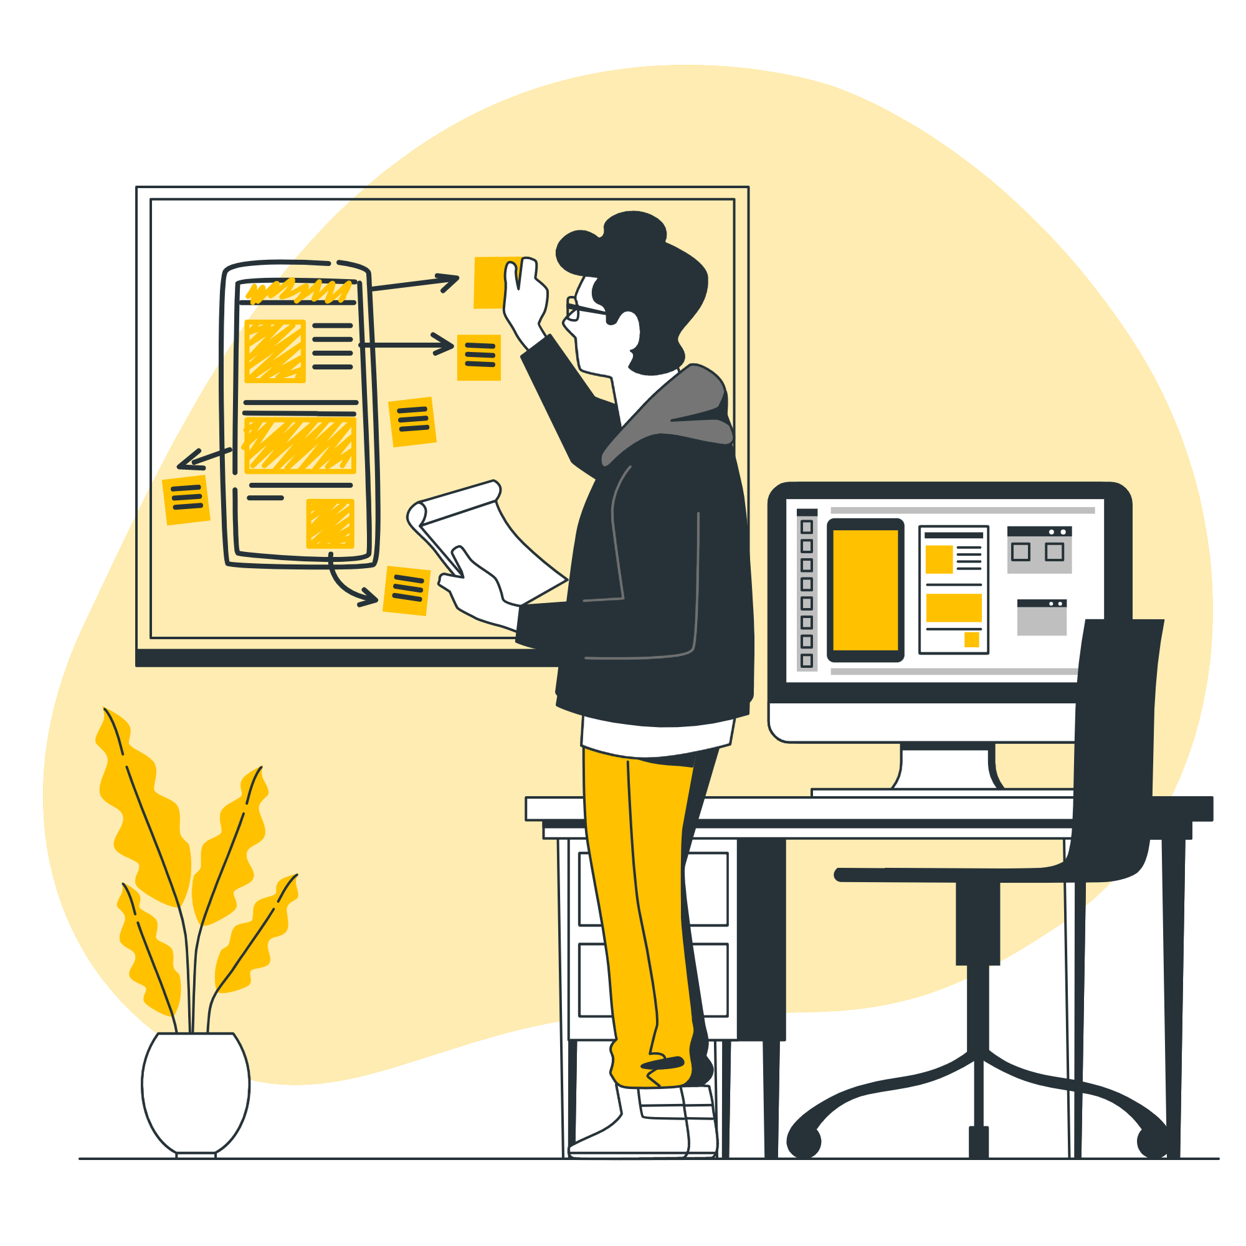
Mobile App Demo
06
Generative models - Generative Pre-trained Transformer 3 (GPT-3) will be utilized to generate a Sinhala summary
Transformer models - Various deep learning models powered by Google Brain (Google’s AI)
LSTM models will be analyzed for text summarization possibilities
Transfer language - instead of training the model from the beginning, closely related languages with similar grammar can aid Sinhala textbook summarization
Other stemming mechanisms and algorithms discussed in the literature review
External libraries and techniques that can be used for the Sinhala language
Notes:
Main focus would be generative models or transformers (deep learning models) finding the best out of those.

Slide 7
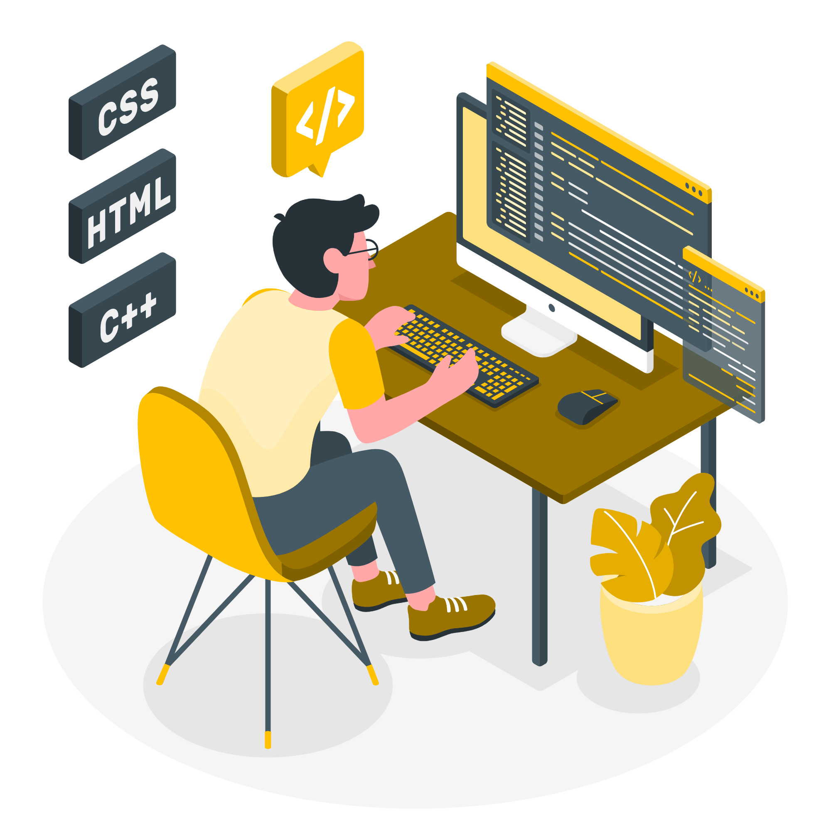
Service Plugin Demo
07
Developed using Python
Notes:
Main focus would be generative models or transformers (deep learning models) finding the best out of those.

Slide 8
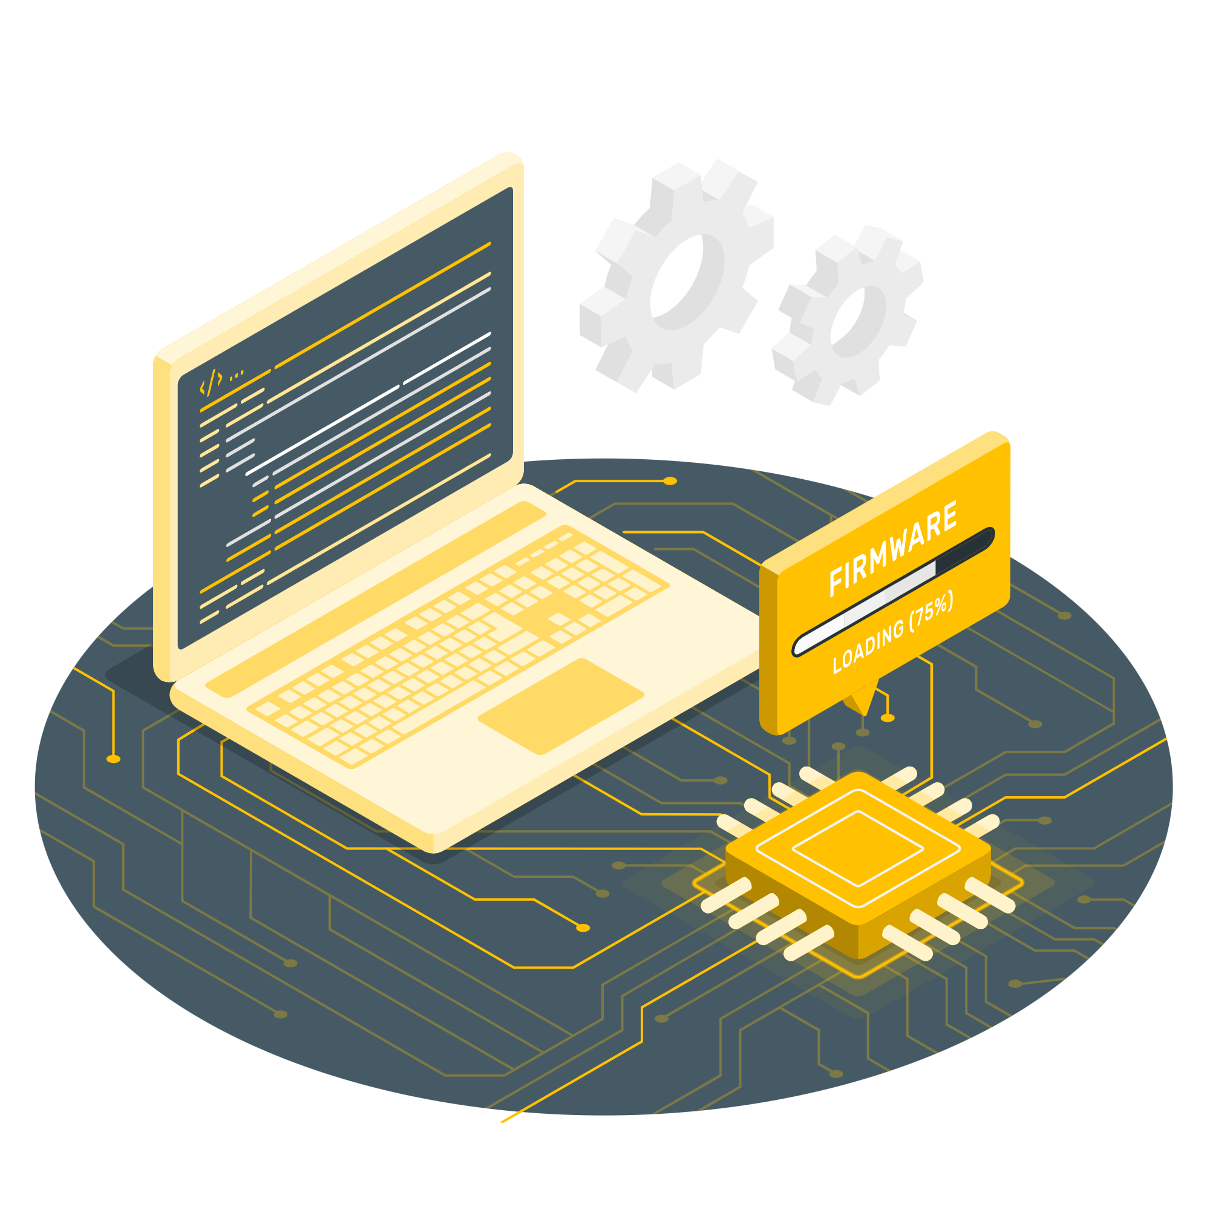
Service Plugin
08
Abstractive Summarization
Extractive Summarization
Notes:
I will be visiting schools, gathering their requirements.
I will be generating a useful data set, which is provided by the SL government
Type of study - This would be carried out as applied Research with a descriptive objective along with an Inquiry mode of Qualitative research.
Google forms, SPSS (Intended Data Analysis Techniques)
Interviews/Questionnaires Snowball sampling technique, which targets a random population.

Slide 9

09
Proposed Testing and Evaluation
Testing Level of Accuracy and Precision
Critical Evaluation on the extractive summarization model and abstractive summarization

Slide 10
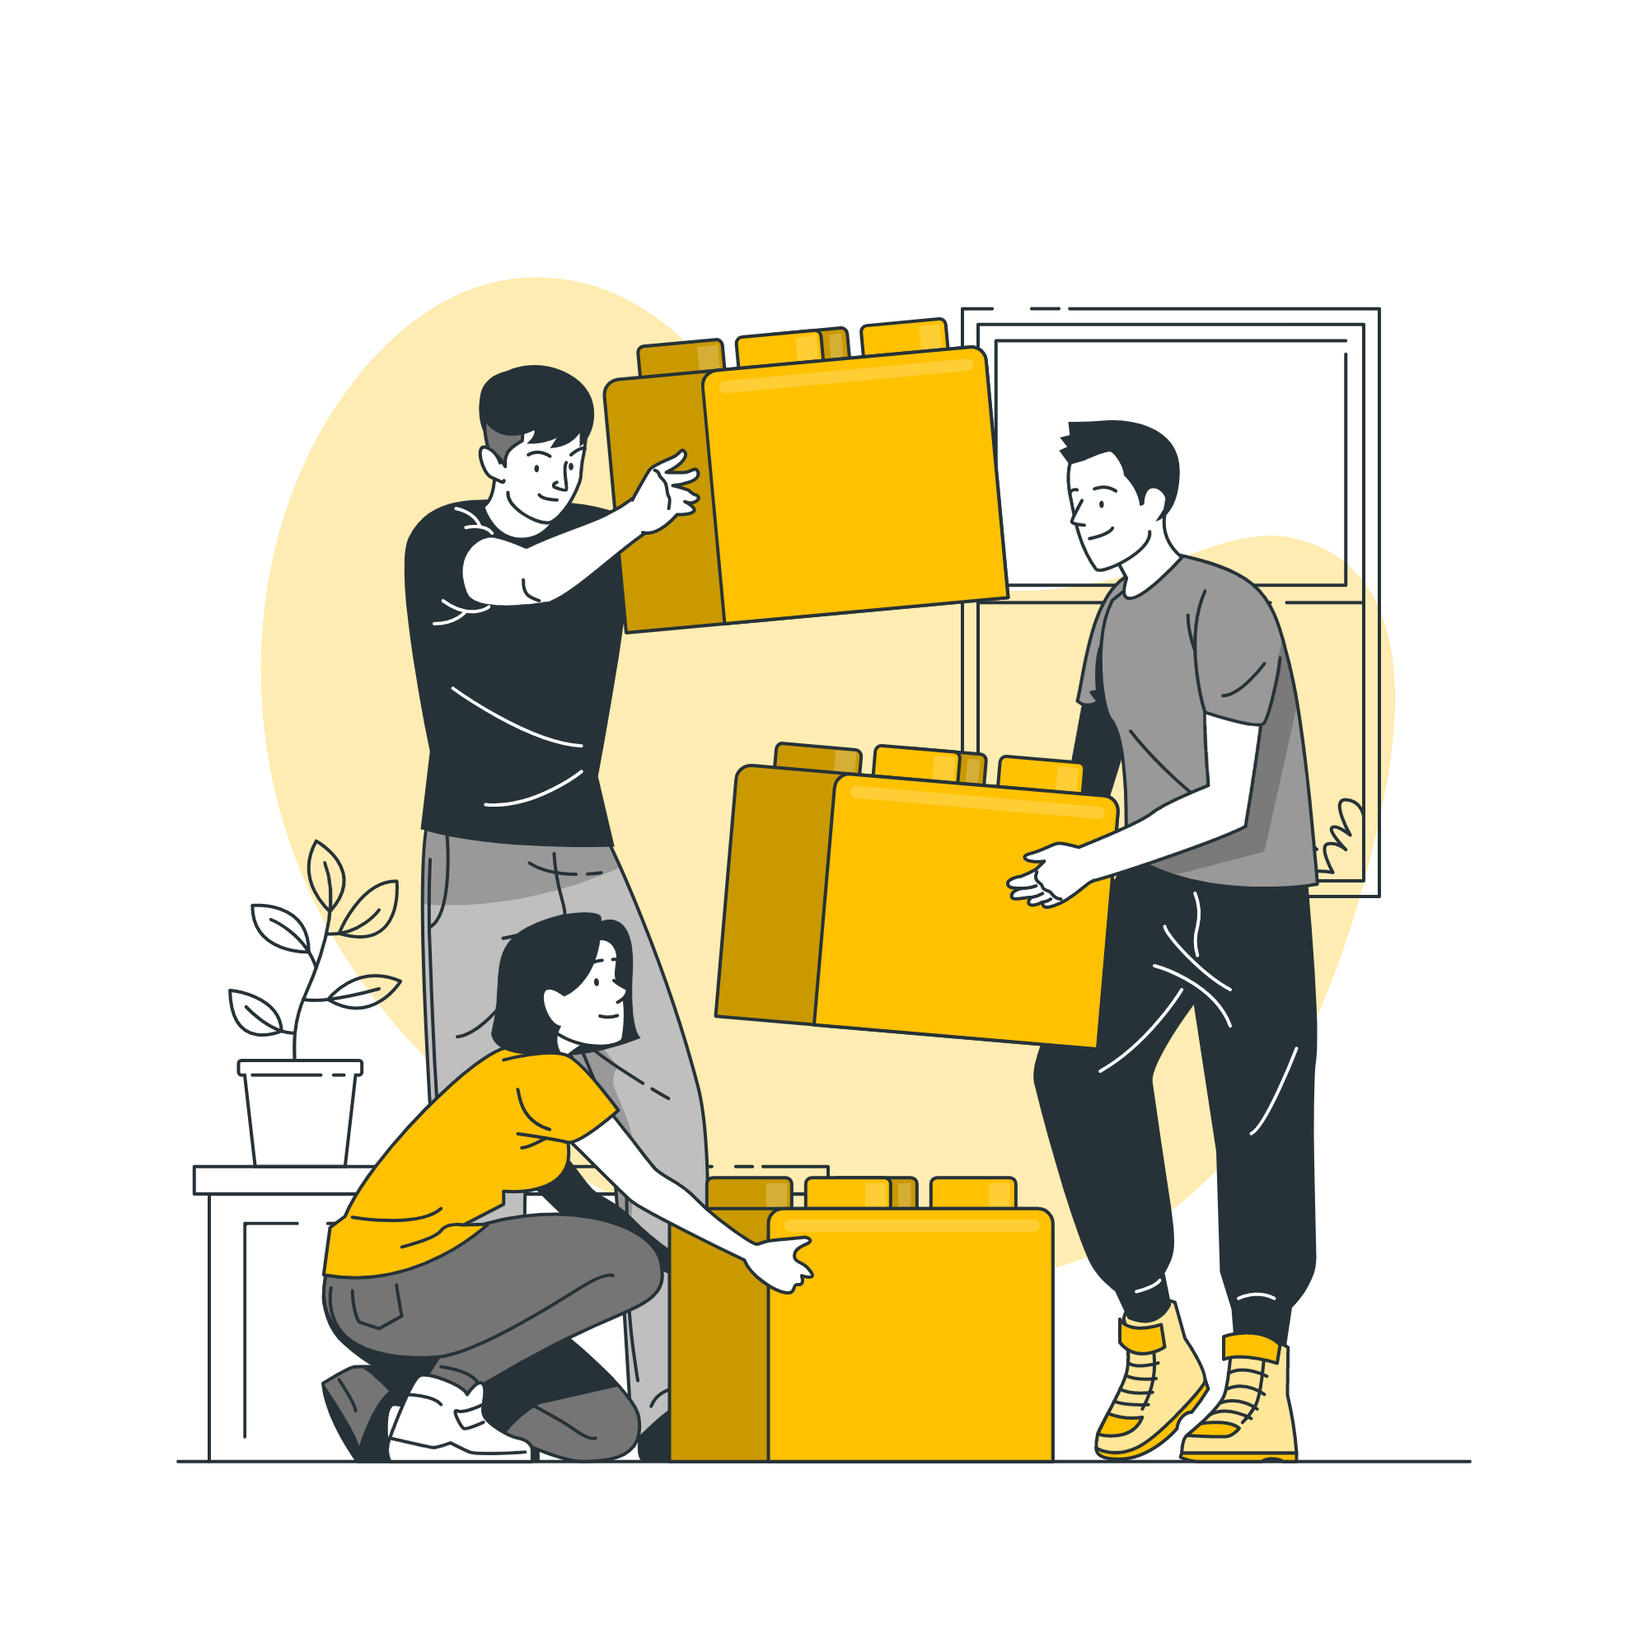
10
Conferences
ICTer 2022
https://icitr.uom.lk/
EDUCON2022
https://educon-conference.org/current/cfp_educon.php

Slide 11

Thesis Structure
11
Main Expected Outcomes
- Exposure of Auto-summarization service as a third-party plugin/library via a RESTful API
Help students overcome their current burning situation of daily carrying a heavy school bag.
Identify if Generative models can be used for text summarization and determine the best model for Sinhala text auto-summarizer
Successfully develop the intended mobile application with features such as auto-summarization to overcome academic barriers with ease.
Reducing paper waste, recycling issues, and trees cut down for paper in Sri Lanka to be reduced drastically.
The ultimate goal is to build a workable mobile application that supports both iOS and Android platforms, that meets the requirements of the aforementioned features.
- Successful research publication
Notes:
Acknowledge supervisor, Dr. Kalpani Manathunga

Slide 12
References
12
[1] Lee, HeeJeong Jasmine, Chris Messom, and Kok-Lim Alvin Yau. "Can an Electronic Textbooks Be Part of K-12 Education?: Challenges, Technological Solutions and Open Issues," Turkish Online Journal of Educational Technology-TOJET 12, no. 1 (2013): 32-44.
[2] V. E. Balas and S. Banerjee, "Seeded text auto-summarization: An experience with simplified statistical and fuzzy ranking algorithm," 2014 IEEE 15th International Symposium on Computational Intelligence and Informatics (CINTI), 2014, pp. 143-146, doi: 10.1109/CINTI.2014.7028665.
[3] O. S. Wimalasuriya, “Automatic Text Summarization for Sinhala,” thesis, 2021.

Slide 13
References
13
[4] W. V. Welgama, “Automatic Text Summarization for Sinhala,” thesis, 2012.
[5] [29] I. Awasthi, K. Gupta, P. S. Bhogal, S. S. Anand and P. K. Soni, "Natural Language Processing (NLP) based Text Summarization - A Survey," 2021 6th International Conference on Inventive Computation Technologies (ICICT), 2021, pp. 1310-1317, doi: 10.1109/ICICT50816.2021.9358703.

Slide 14
THANK YOU

